Slide 1
Residency Requirements for Condominium Directors
Presented by:
Michael C. Kim
Monica Shamass

Slide 2
New Residency Requirements for Board Members of Illinois Condominium Associations per the Illinois Condominium Property Act (765 ILCS 605/18)
Starting January 1st, 2022, there was a new amendment to Section 18(a)(1) of the ICPA which permits a residency obligation for board members.
Associations that were formed before this date can introduce this residency requirement, but the previous residency requirements (that obliged all directors to be residents) will not be enforced under this new law.

Slide 3
Statute Language
18(a)(1) “ The election from among the unit owners of a board of managers, the number of persons constituting such board, and that the terms of at least one-third of the members of the board shall expire annually and that all members of the board shall be elected at large; if there are multiple owners of a single unit, only one of the multiple owners shall be eligible to serve as a member of the board at any one time. A declaration first submitting property to the provisions of this Act, in accordance with Section 3 after the effective date of this amendatory Act of the 102nd General Assembly, or an amendment to the condominium instruments adopted in accordance with Section 27 after the effective date of this amendatory Act of the 102nd General Assembly, may provide that a majority of the board of managers, or such lesser number as may be specified in the declaration, must be comprised of unit owners occupying their unit as their primary residence; provided that the condominium instruments may not require that more than a majority of the board shall be comprised of unit owners who occupy their unit as their principal residence;”

Slide 4
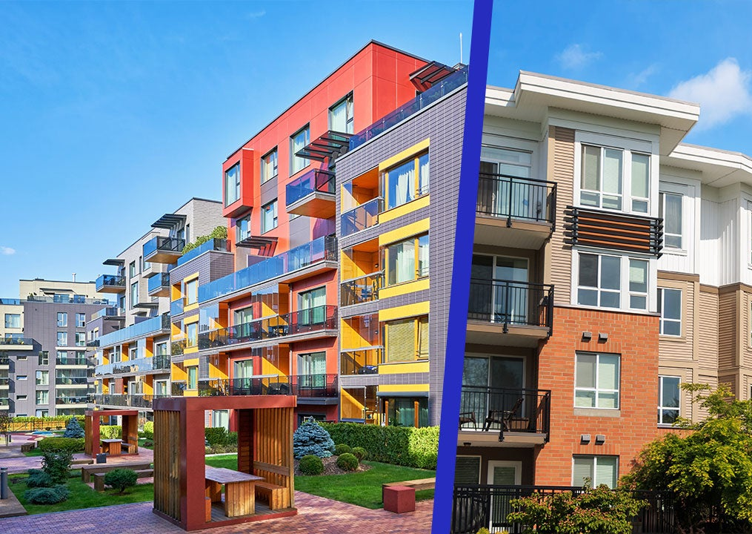
Who does this affect?
Unit owners who want to join the Association’s Board.
What does that mean?
Someone who has the fee simple ownership of the unit or has a leasehold interest in the unit
This in effect could be someone who is leasing, the owner of the unit, or, if it’s an entity, an owner’s representative.

Slide 5
What Qualifies as a ‘Principal’ Residence/Primary Residence per the Act?
According to Section 18(a)(1) of the ICPA, the phrases "principal residence" and "primary residence" appear to be used in the same manner. There's no additional explanation given, and these phrases aren't utilized anywhere else in the Act.
The responsibility to clarify the definition of "principal residence" falls on the association, and if required, a court of law can do so through a policy statement or other measures.

Slide 6
What is the general definition?
Generally, a principal residence refers to the primary dwelling where an individual mainly resides.
It's different from a vacation home or a temporary/transitory dwelling.
Some definitions describe it as the place an individual spends the majority of their time, carries out activities like receiving mail, paying bills, and registering to vote.

Slide 7
How can you formulate a definition?
One method to forming a definition for your association is to other statutes or governmental departments’ definitions.
According to the Illinois Department of Revenue, a principal residence is the primary dwelling where a person lives, usually where they receive their mail, vote, and file their taxes. It is generally the “home” where a person spends the majority of their time, where they have this personal property (such as furniture and clothing) and has their most important personal and economic ties.

Slide 8
Other Illinois elections with residency req’s
Governor: a candidate must be a resident of the State for at least three years preceding the election. (Source: Article V, Section 2 of the Illinois Constitution)
Lieutenant Governor: A candidate must have been a resident of the State for at least three years preceding the election. (Source: 10 ILCS 5/5-15)
State Senator: A candidate must have been for at least two years preceding the election. (Source: 10 ILCS 5/8-5)
State Representative: A candidate must have been a resident of the district he or she seeks to represent for at least two years preceding the election. (Source: 10 ILCS 5/8-5)
Mayor: A candidate must have been a resident of the municipality for at least one year preceding the election. (Source: 65 ILCS 5/3.1-10-5)
City Council Member: A candidate must have been a resident of the municipality and the ward he or she seeks to represent for at least one year preceding the election. (Source: 65 ILCS 5/3.1-10-5)
Illinois State Board of Elections: A candidate must be a resident of the State of Illinois and a qualified voter in the state for at least two years preceding the appointment.

Slide 9
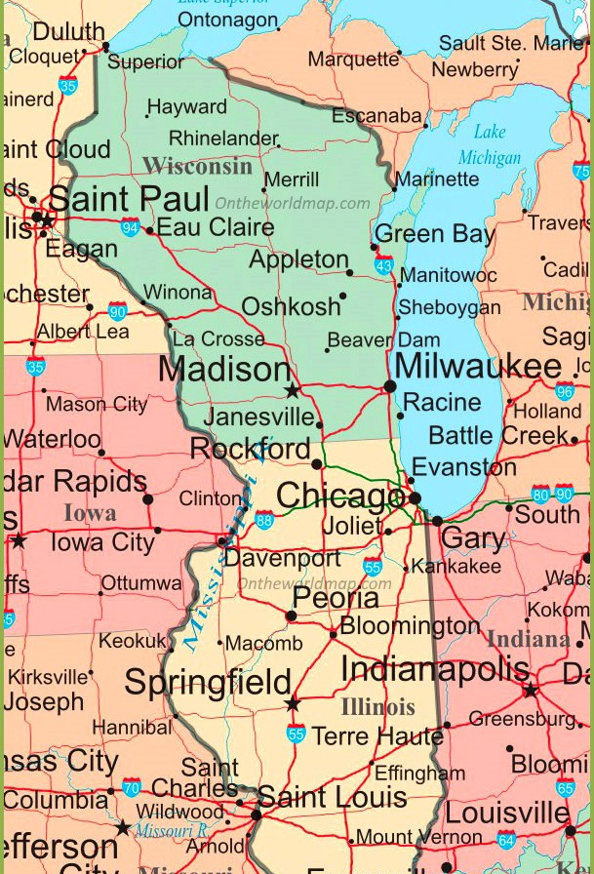
Nearby states residency req’s for associations
Indiana
Indiana's Condominium Act (IC 32-25) has no specific residency requirements to serve on a condominium association board in Indiana other than needing to be a unit owner.
Wisconsin
Under the Wisconsin Condominium Ownership Act (Wis. Stat. Chapter 703), there are no specific residency requirements to serve on a condominium association board.

Slide 10
More Metropolitan Examples:
New York
The New York Condominium Act (Real Property Law Article 9-B) requires that a board member must either own a unit in the condominium or be the designated representative of a unit owner. New York does not have particular rules regarding felony convictions and immediate dismissal such as Florida.
Florida
Under Florida law (Florida Statutes §§ 718.112(2)(d) and (o)), there are no specific residency requirements to serve on a condominium association board. However, the Florida Condominium Act (Chapter 718) does highlight that they should not be delinquent on the payment of any fees or convicted of a felony.
California
The California Civil Code (§§ 4000-6150) has similar language to Florida. No residency requirements but particulars when it comes to crimes that would interfere with the association’s ability to obtain fidelity bond insurance coverage for the person.

Slide 11
Possible factors to determine residency:
Length of ownership
Length of continuous occupancy
Period of “primary residency” in the unit
Variance of occupancy from year to year.

Slide 12
Pros and cons of residency req’s:
Pros
Improved management and maintenance of the property
Better representation for the community
Cons
Limits the pool of eligible board members
Lack of Fresh Perspectives and Limitations on Investors and Part-Time Residents

Slide 13
Alternatives to residency requirements
Board member training and education
Hiring professional management companies
Creating committees for specific tasks
Ensuring all board members are informed of the building's operations

Slide 14
In conclusion…
Ultimately up to the association to decide and should be based on the unique needs of each association
May not be the best route to take. Though residency requirements can lead to improved management and better representation for the community, they may also limit the pool of potential candidates and the diversity of them
Could have expansive implications regarding other distinctions made within the membership of the association

Slide 15
Sample amendment to impose a residency requirement
Commencing with the 202_ annual election of directors, a [simple] majority of the total number of directors shall occupy their respective Units in the Condominium as their principal residence, being denominated as Resident Directors. If at any time a director ceases to occupy a Unit owned by that director as a principal residence, then in that event, that director shall not be deemed or counted as a Resident Director. For purposes of determining residency, [a Unit Owner must occupy the Unit for a minimum of __ days in the aggregate for [a calendar year] [or] [the last consecutive twelve-month period]. OR [the Board shall adopt rules and regulations setting forth specific criteria].

